Slide 1
An Efficient and Usable Client-Side Cross Platform Compatible Phishing Prevention Application
FINAL YEAR PROJECT REPORT
Guide
Dr. Angelin Gladston
Associate Professor
Department of CSE
Submitted by
N. Dhanush 2016103021
G. Santhosh 2016103057
S. Ben Stewart 2016103513

Slide 2
OUTLINE
INTRODUCTION
OVERALL OBJECTIVE
LITERATURE SURVEY
PROPOSED SYSTEM
SYSTEM ARCHITECTURE
REFERENCES

Slide 3
INTRODUCTION
Phishing
Lists of such sites
Time constraints
Computational resources
Vulnerabilities
Cross platform

Slide 4
OVERALL OBJECTIVE
Create a phishing list
Cross Platform application
Web browser add-on
Provide temporal resilience
Remove false positives from list

Slide 5
LITERATURE SURVEY
Previous work by Samuel Marchal, Giovanni Armano, Tommi Grondahl, Kalle Saari, Nidhi Singh, and N. Asokan
Implemented a client-side phishing prevention application.
Had background tasks communicate with a browser add-on.
Not platform independent.

Slide 6
PROPOSED SYSTEM
Platform independent
Browser add-on
Reduce false warnings
Split words properly
Context independent detection
Static observations

Slide 7
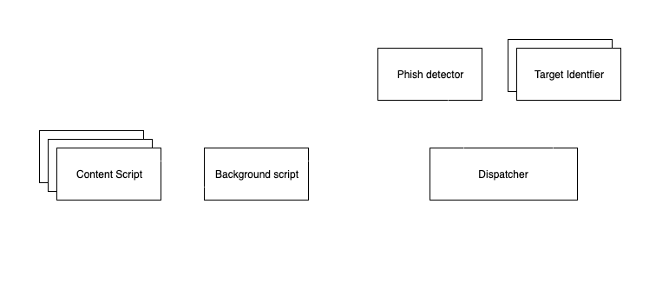
SYSTEM ARCHITECTURE

Slide 8

DETAILED
SYSTEM ARCHITECTURE

Slide 9
REFERENCES
S. Marchal, G. Armano, T. Gröndahl, K. Saari, N. Singh, N. Asokan, "Off-the-hook: An efficient and usable client-side phishing prevention application", IEEE Trans. Comput., vol. 66, no. 10, pp. 1717-1733, Oct. 2017.
A. K. Jain, B. B. Gupta, "A novel approach to protect against phishing attacks at client side using auto-updated white-list", EURASIP J. Inf. Secur., vol. 2016, no. 1, Dec. 2016.
G. Xiang, J. Hong, C. P. Rosé, L. Cranor, "CANTINA: A feature-rich machine learning framework for detecting phishing Web sites", ACM Trans. Inf. Syst. Secur., vol. 14, no. 2, 2011.
Implementation for the Usage of Google Safe Browsing APIs (v4), 2019, [online] Available: https://github.com/google/safebrowsing.
C. Whittaker, B. Ryner, and M. Nazif, “Large-scale automatic classification of phishing pages,” in Proc. Netw. Distrib. Syst. Security Symp., 2010, pp. 1–14.

